Slide 1
Scaling Innovation Expectations to Fit Your Corporate Reality
Presented By:
Greg Case
Chief Innovation Officer
Taco, Inc.

Slide 2
When I say the word “Innovation”,
What visions do you see in your head?

Slide 3
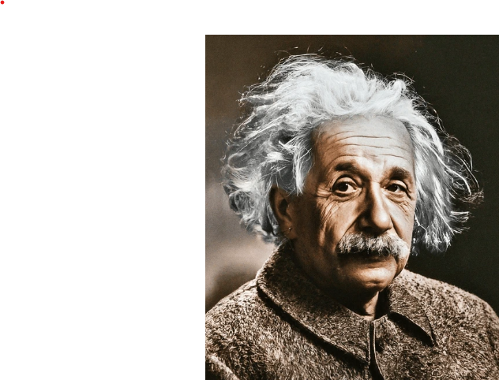
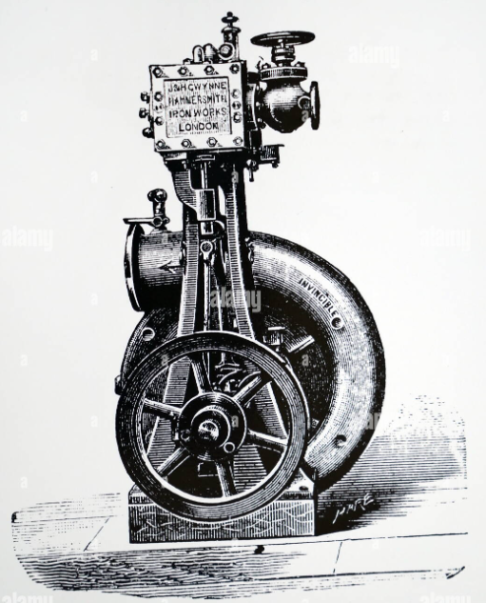
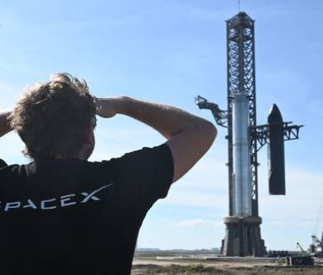

Slide 4
Did you think about the change to the accounting process that accelerates the time to close the books each month by 4 days and reduces the person hours by 25%.
Did you think about the process change that improved delivery time by 2 weeks and decreased shipment errors by 56%.

Slide 5
Innovation is a Team Sport

Slide 6
Innovation is Everyone’s Job and Everyone must Innovate to Move your Organization Forward

Slide 7
4 Evaluation Areas

Slide 8
Technology
Financial
Resources
Culture

Slide 9
Technology

Slide 10
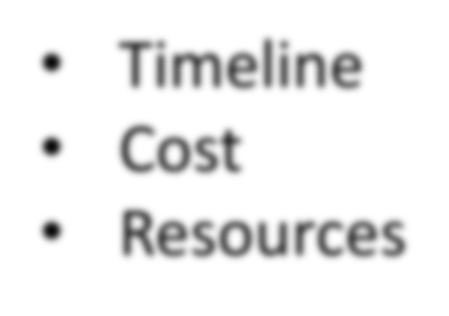
Does the needed technology exist?
Is it within your Organization?
Can you Partner with or Buy Someone That Has It?
Has it been used in another industry?
Does it need to be invented?

Slide 11
Financial

Slide 12
Does This Project Move the Needle? (30% Revenue Increase)
What are the real costs?
Project Cost = (Your Estimate) x (2 to 5) (Known Tech)
Project Cost = (Your Estimate) x (5 to 10) (Unknown Tech)
Is What You're Asking for Realistic?
Can you company afford to do the project?
Partners/Grants?/ Angel Investors?

Slide 13
Resources

Slide 14
Champion - Obsessed with This Projects Success!
Executive Sponsor - Almost as obsessed as the Champion.
Executive Team Buy In?
The Team:
Do You have the Right Inspired
People?
Do they have the Right Skillsets?
Are They Available?
Facilities:
War Room, Lab/Prototype Space, Beta Sites (Difficult)
Cash Strapped, Under-Staffed, Extreme Time Pressure, Stretch Goals

Slide 15
Culture

Slide 16
Sometimes This Squishy Thing Called Culture is the Most Important Factor!

Slide 17
Are People Encouraged to Take Risks?
What Happens When They Fail (Intelligently)?
Psychological Safety – Dr. Amy Edmonson- Havard
90%-95% of Scientific Experiments Result in Failure
Are People Encouraged to Speak Up When They See a Problem?
If Not Go For Smaller Scale Projects
Does the Project Violate Any Sacred Cows?

Slide 18
What If Your Innovation Scale Does Not Match Your Organization?

Slide 19
You Could Move On.
Build Your Success Portfolio
Smaller Scale Wins Build To Larger Scale Projects
Build A Balanced Portfolio
A Couple Horizon 3 Projects
A Few Horizon 2 Projects
Several Horizon 1 projects

