Slide 1
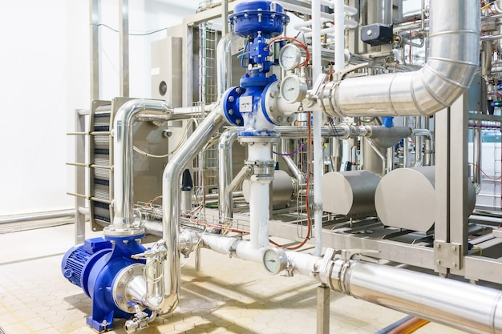
Pump Industry Fundamental Body of Knowledge
Pump System Optimization and Assessment Principles

Slide 2
Agenda
Pump Industry Fundamental Body of Knowledge
Introduction to the Pump Industry Knowledge Areas
Overview of Pump System Fundamentals
Overview of Pump System Assessment Principals
Overview of Pump System Optimization Principals

Slide 3

Pump Industry Fundamentals Body of Knowledge (BOK)
The Pump Industry Fundamentals Body of Knowledge covers general pump system fundamental knowledge requirements (learning outcomes) that should be common across job functions and industries.
Each learning outcome contains multiple primary topics required for professionals working in the pump and fluid handling industries; however, it does not provide the actual training.
The learning outcomes described cut across engineering, manufacturing, sales, distribution, consultants, owners and operators of the pumping system.
It is understood that certain markets will have specific knowledge requirements, but it is not the intent of this document to cover these in detail.
This Body of Knowledge is intended to act as a roadmap to guide the user in their quest to outline fundamental training or knowledge requirements for markets and job positions in the pump industry.
Notes:
The BOK is a newly developed HI document that covers general pump system fundamental knowledge requirements that should be common across all job functions and industries
The BOK is intended to act as a path to guide the user in their quest to outline fundamental training or knowledge requirements for various markets and job positions in the pump industry

Slide 4
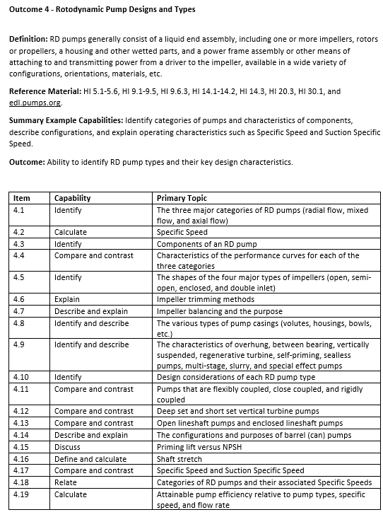
Pump Industry Fundamentals Body of Knowledge (BOK)
There are 16 Learning Outcomes identified, each of which consists of multiple Primary Topics.
Learning Outcomes
      Introduction to Pumps
      Pump Performance Curves and Power Consumption
      Pump Systems
      Rotodynamic Pump Designs and Types
      Positive Displacement Pump Designs and Types
      Pump Components and Accessories
      Drivers and Drives
      System Design Considerations
      Varying the Pump Operating Point
      Pump Selection, Specification, and Application Engineering
      Testing
      Pump Installation, Commissioning, and Startup
      Maintenance
      Troubleshooting
      Pump System Optimization and Analysis
      Markets and Applications
Notes:
The BOK identifies 16 learning outcomes that are comprised of multiple primary topics

Slide 5
Goal of the Body of Knowledge
A Career in Pumping: It is a noble calling. The pump professional can make peoples’ lives better – by providing drinking water for a thirsty world, removing sewage and waste from where we live to where it can be treated, processing fluids for the goods we manufacture, delivering irrigation water for the foods we eat, refining, supplying and generating the energy products that we need to keep our world on the move, keeping our living spaces comfortable throughout the seasons, and making many other benefits available to an ever-expanding world.
The primary goal of this Body of Knowledge is creation of a systematic learning path for a deep understanding of hydraulic system behavior and pump performance characteristics along with their relationships to overall system operation. This will enable better decision-making by the pump professional to assure user satisfaction through proper pump system operation, reduced energy consumption, and improved reliability.
Notes:
The primary goal of the BOK is to create a learning path for a deep understanding of hydraulic system behavior and pump performance characteristics along with their relationships to the overall system operation. This will enable better decision-making by the pump professional to assure user satisfaction through proper pump system operation, reduced energy consumption, and improved reliability.

Slide 6
Need for the Body of Knowledge
Industry Need: Like most industrial and manufacturing industries, the pumping and fluid handling industry is facing workforce challenges, which includes attracting young professionals to the engineering, manufacturing, construction, and municipal industries. These industries have experienced workforces that are moving towards retirement and taking significant knowledge with them. Once a new employee is hired, companies have the critical task of educating and training them on their processes, products, or services they deliver. However, before starting on this, the fundamentals must be known, which this document will support.
Notes:
Part of the need for the BOK was to support the Hydraulic Institutes workforce development initiative to assist the pump industry in attracting, developing and retaining talent. As we know, one of the many challenges in the industry is the loss of experienced workforces that are taking a significant amount of knowledge and experience with them. Once an employee is hired, companies now have the critical task of educating and training them. The fundamental knowledge areas must be known. This document will support that task

Slide 7
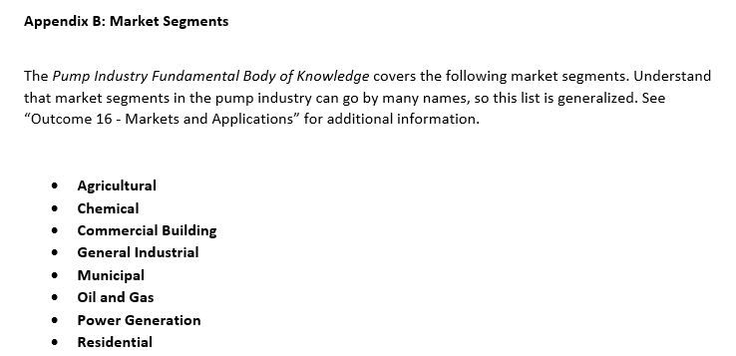
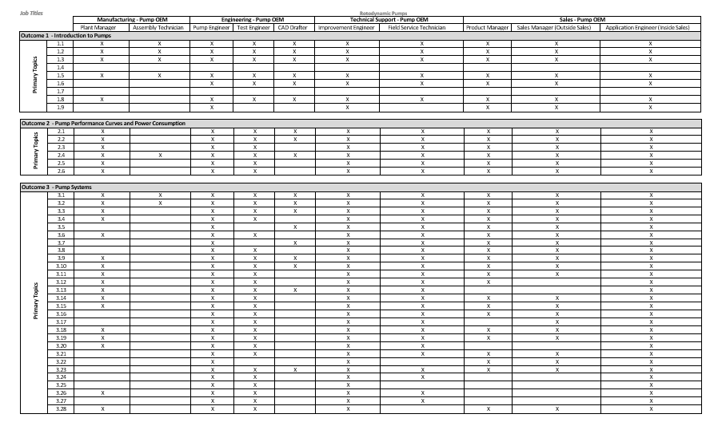
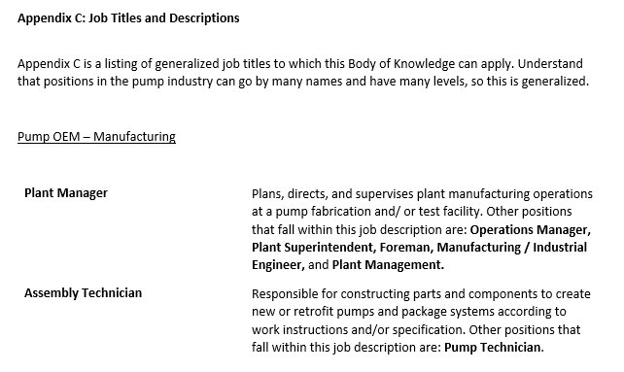
Pump Industry Fundamentals Body of Knowledge (BOK)
Analysis has demonstrated that job titles and markets can be linked to specific training needs.
Appendices B, C, and D provide definition and generalized guidance on the depth of training by primary topic required for those with job titles and in the markets as indicated.
Notes:
The BOK consists of appendices that provide guidance on the depth of knowledge required not only for specific market segments but for job titles and functions as well. As you can see in the table, we are looking at learning outcomes 1, 2 and 3 that identify the primary topic knowledge areas associated with the job functions listed above

Slide 8
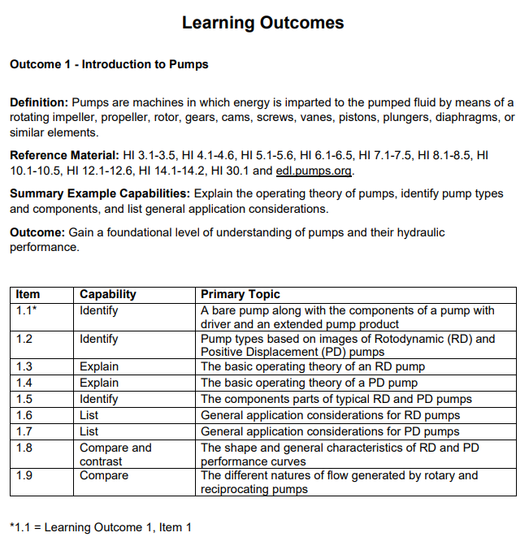
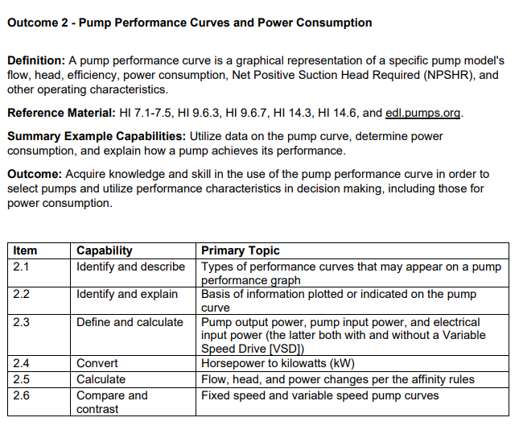
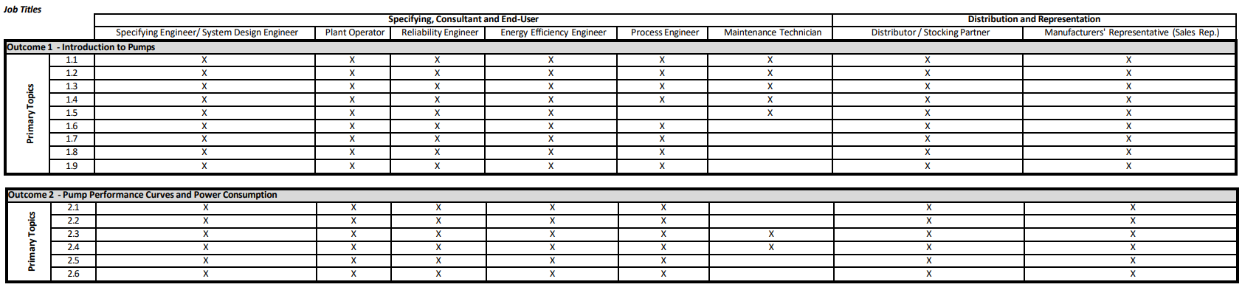
Learning Outcomes 1 & 2
Notes:
Lets take a look at learning outcomes 1 and 2. Learning outcome 1 the Introduction to Pumps and learning outcome 2, pump performance curves and power consumption. Review

Slide 9
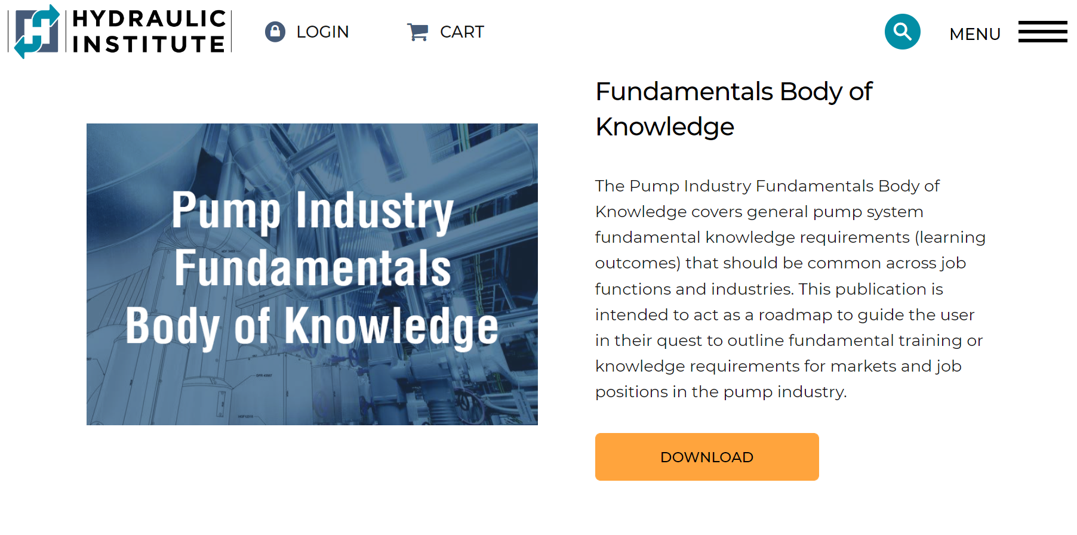
Free Download Available
New HI Document HI 40.9-2022
  Available as a free download on the HI website
https://training.pumps.org/
https://www.pumps.org/
Notes:
The BOK is now available for free download at pumps.org or training.pumps.org

Slide 10
Next Steps – Prerequisite Training
Goal: Develop an entry level curriculum for technical and non-technical roles
Pump Basics – Role of the pump and types
Pump Terminology Basics – Basic pump terms with definitions / examples.
Fluid Basics – Basic fluid properties, definitions with examples.
System Basics – High-level system description, function, components, and how it correlates to the pump.
Driver Basics - Drivers and their role in the pumping unit.
Pump Operating Theory Basics – Basic difference between a RD and PD pump. (How they develop flow / pressure)
Pump Application Basics – Overview of basic hydraulic information (flow, head, power).
Notes:
Before an individual can dive into the BOK the must have some basic introductory knowledge of pumps and systems. These areas are…

Slide 11
Overview of Pump System Fundamentals

Slide 12
Pump System Fundamentals
Introduction to Pumps and Pump Systems
Pump Types- Rotodynamic (Centrifugal) and Positive Displacement
The Importance of the Pump Curve
Modifying the Pump Curve
Pump Control Methods
Pump Operating Point
Notes:
Today we will cover some of the topics that are instructed in our pump system fundamentals course that will provide a foundation for being able to proceed into being able to assess and optimize a system for greater operational reliability and energy efficiency

Slide 13
Introduction to Pump Systems

Slide 14
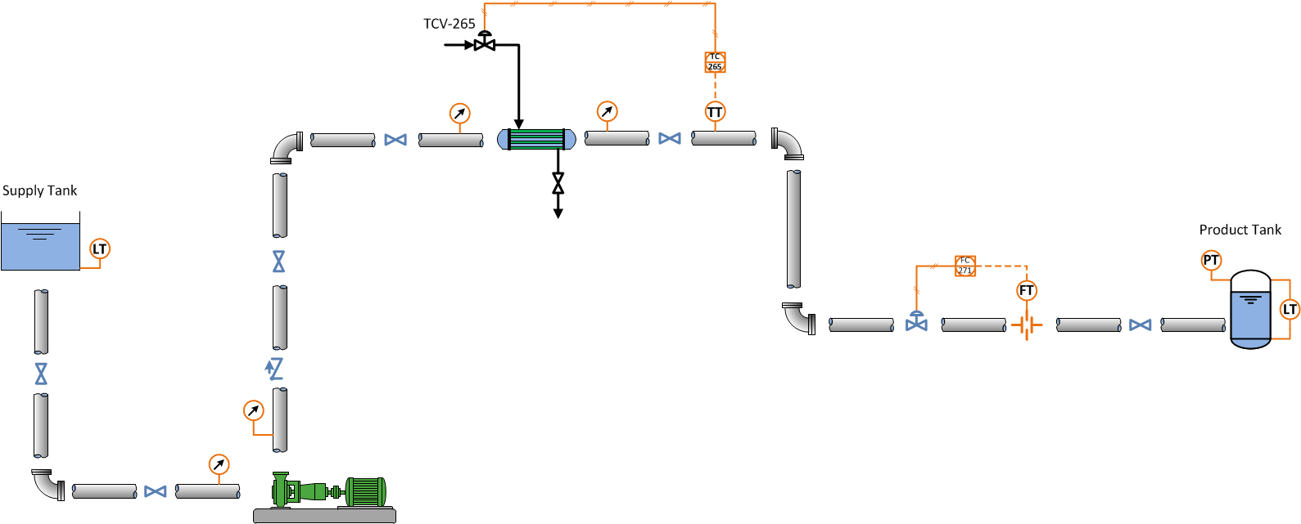


Introduction to Pumping System
System configuration, fluid, and purpose depends on the application
Moving fluid requires energy and cost money
Devices interconnected with pipelines that use the mass and energy of a fluid to perform work, carry out a process, or to make a product
Notes:
So, what is a pump System?
- -
A pumping system is a collection of devices that are interconnected with piping. A pumping system is designed to use the mass and energy of a fluid to perform work, perform a process, or to make a product. The devices in a piping system may include:
-- tanks and vessels to supply or store the fluid,
-- pumps that add energy to the fluid,
-- components such as a heat exchanger,
-- control valves to regulate key operating parameters for the system,
-- automatic controls for the key operating parameters
-- and other instrumentation to measure tank levels and pressures at key locations in the system
-- as well as isolation valves and other fittings such as elbows, reducers, and tees.
Pump system fundamentals provides you with an understanding of how pumps operate and interact with the system. Each component within the system consumes energy, and the pump has to supply that energy in a supply amount that equals the consumption amount.
The configuration of the piping system, the fluid used, and the purpose of the system will vary depending on the application, but there are fundamental concepts, principles, and mathematics that apply across industries and disciplines.
Of course, moving the fluid through the piping system requires energy, and that energy costs money. The better a system is designed and operated, the less money we have to spend to meet the requirements of the system.
One key to understanding any pumping system is to understand the energy state of the fluid throughout the system, as well as the energy addition and losses in the system.
Pumping systems use energy in many forms, including:
-- electrical energy that is used to turn a motor
-- mechanical energy of the rotating pump shaft
-- hydraulic energy in the form of pressure, velocity, elevation head
-- thermal energy due to the fluid’s temperature
There is also energy loss occurring in the system in the form of HEAD LOSS in every device in the system. This head loss results in heat, noise, vibration that wear down the equipment. It also results in a drop in static pressure across each device.

Slide 15
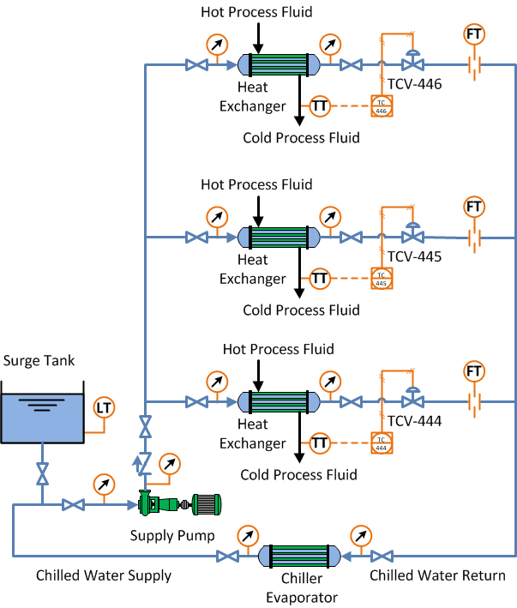
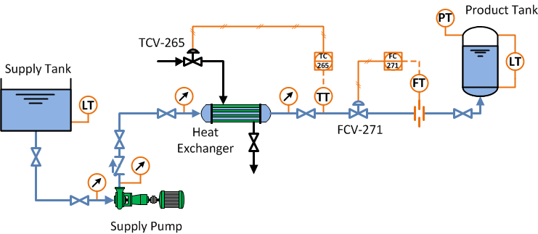
Types of Systems
Multi-loop closed systems
Single path open systems
Notes:
Let’s look at the typical piping system configurations you may encounter.
Piping systems are either OPEN systems or CLOSED systems.
Two animations –
The configuration of an open system (open to atmospheric pressure) (Animation 1) shown here is a simple single path system that transports a liquid from a single source to a single end use.
Systems can also be closed (operate above or below atmospheric pressure) (Animation 2) shown here as a more complex multi-loop system where the flow goes through heat exchangers and then a chiller before returning to the pump inlet.
The equipment in the system depend on what processes are occurring in the system, such as heat transfer, fluid flow, or chemical reactions.
Instructor use below as needed
Each system will have unique operating characteristics based on the hydraulic performance of the components in the system. The operating characteristics will depend on:
-- the liquid levels and pressures in the tanks in the system
-- the performance of the pumps in the system
-- the resistance of components such as a heat exchanger.
-- the size and length of the piping, the number and type of valves and fittings
-- the key parameters that are measured and controlled: flow, pressure, level, temperature

Slide 16
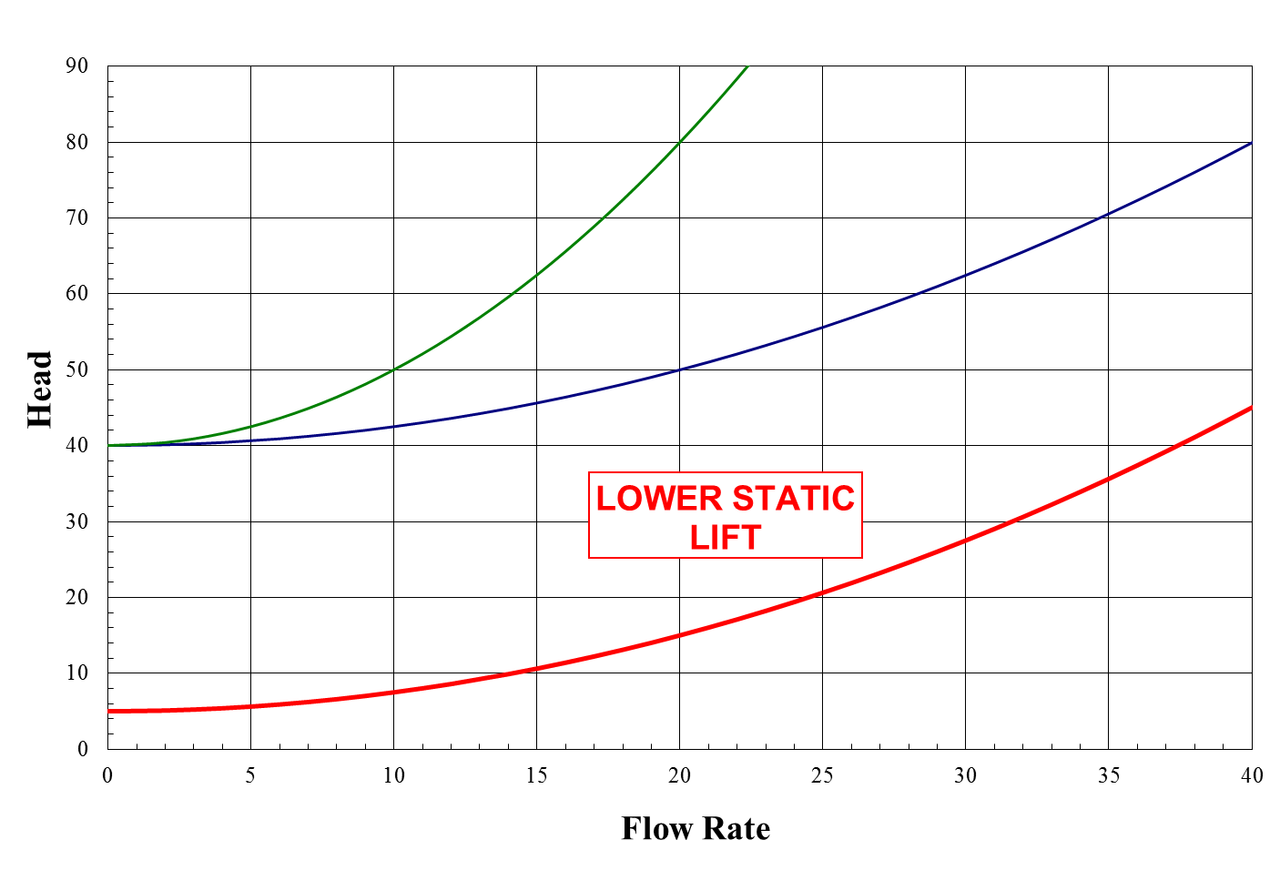
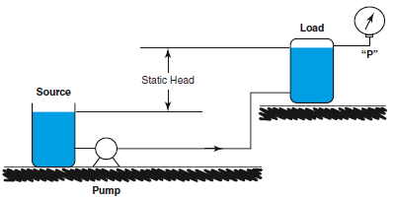
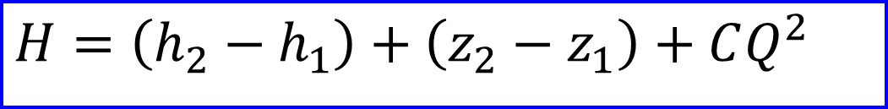
System Curve – Static & Friction
H – pump total head (system head)
h – pressure head (static)
z – elevation (static)
C – friction coefficient
Q – flow rate
$$H=\left(h_{2}−h_{1}\right)+\left(z_{2}−z_{1}\right)+CQ^{2}$$
Lower static head
Notes:
SO we have two forms of head that effects the system curve. Static and Friction head. Static head is the pressure resulting from a column of liquid acting under gravity. Friction head is the energy lost from the movement of fluid in a pipe as a result of friction between the moving fluid and its conduit
2 ANIMATIONS – showing static and then friction head
So as we said, while you often cannot change the static head (Click 1), the friction portion is often an energy reduction opportunity. For instance, if we partially close a valve (Click 2) on the discharge side of the pump (second animation), the C will increase, and we will have a steeper, higher head system curve, as shown by this upper green arc.
So this slide shows what happens if we change either the static head or friction head.

Slide 17
Pump Curve
Notes:
This illustration shows the difference between a typical rotodynamic and positive displacement pump curve.
Note that due to their design differences, positive displacement and rotodynamic pumps will have different curve shapes. In this curve, as in most pump curves, the flow is on the X axis (horizontal) and head is on the Y axis (vertical).
The major difference, is that rotodynamic pumps will have a maximum head produced as flow rate is reduced, but generally positive displacement pump do not. This can be seen by the curves depicted here as function of flow rate. Note how with a Rotodynamic pump, a small change in head or pressure can make a big difference in flow. But with a Positive Displacement pump, a big change in head or pressure has almost no impact on flow.
The PD pump has practically a vertical curve – meaning that at a given speed the flow will be nearly constant regardless of the head in the system.

Slide 18
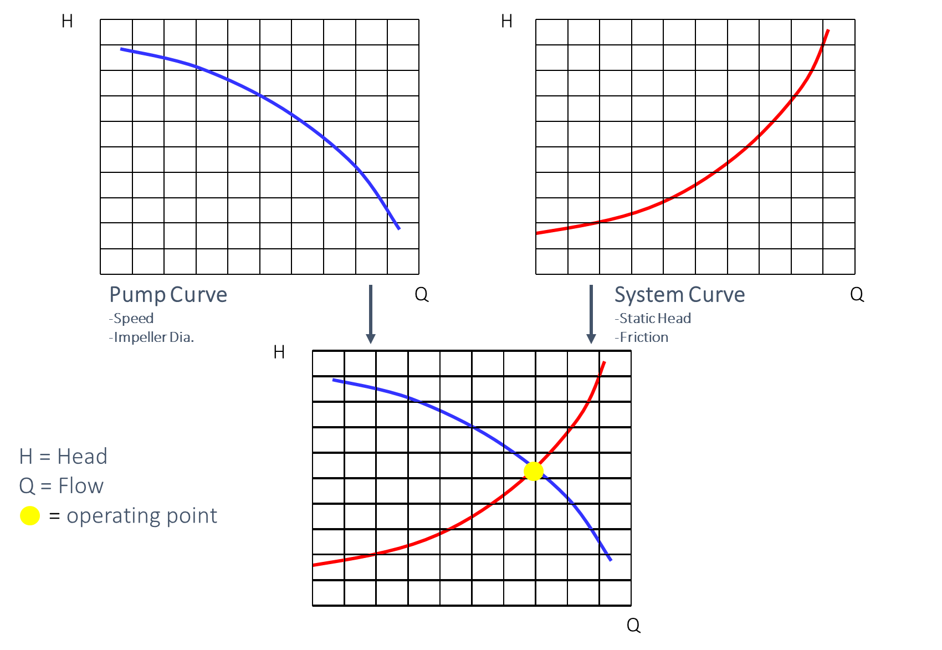
Pump + System Curves
Notes:
Here are examples of a pump and system curves. For fixed speed pumps, the operating point is located at the intersection of the pump and system curves. There is only one operating point for a given fixed speed pump.​
​
​

Slide 19
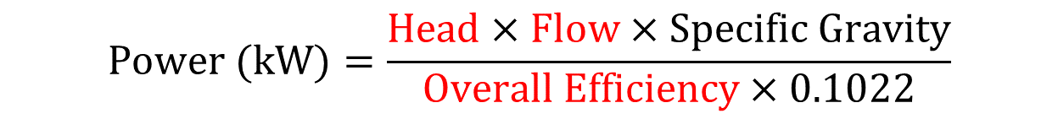
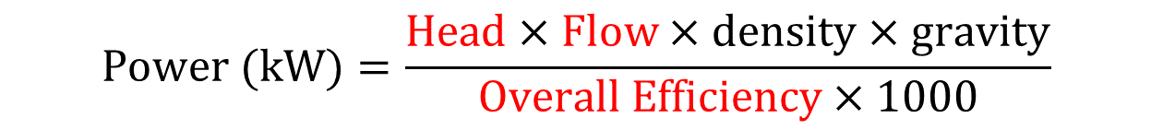
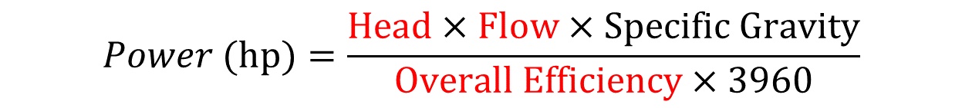
Pump Power Consumption Summary
Metric Units
Metric:
Head = m
Flow = m³/s
Density = kg/m³
Gravity = 9.81 m/s²
Specific gravity = dimensionless
Efficiency = dimensionless
$$Power (kW)=\frac{Head×Flow×density×gravity}{Overall Efficiency×1000}$$
$$Power (kW)=\frac{Head×Flow×Specific Gravity}{Overall Efficiency×0.1022}$$
US Units
US Units:
Head = ft
Flow = gpm
Specific gravity = dimensionless
Efficiency = dimensionless
$$Power (hp)=\frac{Head×Flow×Specific Gravity}{Overall Efficiency×3960}$$
1 hp = 0.746 kW
Overall Efficiency – Pump × Motor × Drive
Notes:
In summary the total pump system power consumption includes the head, flow, density/specific gravity, and component efficiencies.
If we want to reduce our power consumption, highlighted in red are the variables that can typically be adjusted through control, design, and selection.

Slide 20
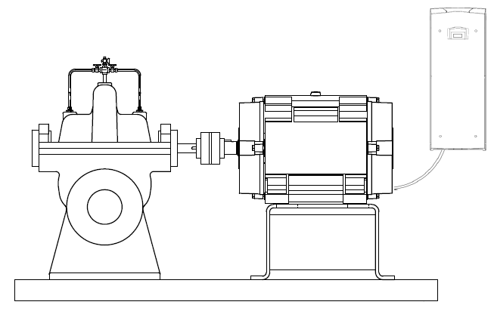
Power Consumption
Pump means equipment that is designed to move liquids (which may include entrained gases, free solids, and totally dissolved solids) by physical or mechanical action and includes at least a bare pump and, if included by the manufacturer at the time of sale, mechanical equipment, driver, and controls.
Control
Control (VFD) input power (P_{Drive})
Driver
Bare Pump
Motor input power (P_{Mot})
Pump output power (P_{w})
Pump input power (P)
Each power decrease by the component efficiency
Property of Pump Systems Matter - All Rights Reserved
Notes:
Presented here is a regulatory definition, which states that pumps move liquids by physical or mechanical action and can include mechanical equipment driver and controls.
This definition includes the driver and controls, which is typically a motor and speed control. We refer to this as the extended pump product.
Animations (4): it is important to understand the power into each device starting from the left will be greater than what comes out. Notice the arrows representing power are getting smaller as we move from the left. This is due to the fact hat each component of the pump extended product has an efficiency that is less than 100%.

Slide 21
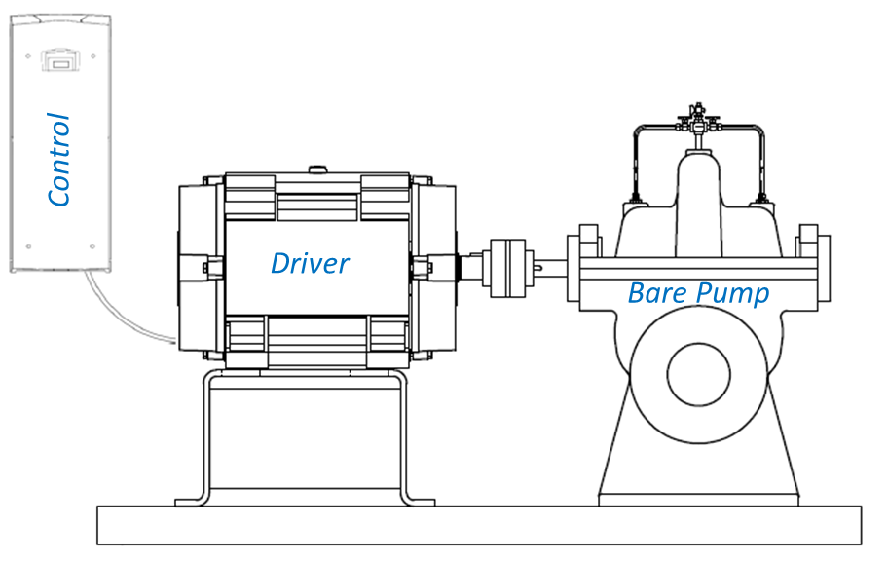
Efficiency
Efficiency is the ratio of power in and power out
We will discuss several types of efficiency
  Pump Efficiency
  $η=\frac{Pw}{P}×100$
  Motor Efficiency
  ${η }_{Mot}=\frac{P}{P_{Mot}}×100$
  Drive Efficiency
  ${η }_{Drive}=\frac{P_{Mot}}{P_{Drive}}×100$
  Overall Efficiency
  ${η }_{OA}=\frac{P_{W}}{P_{Mot}}×100$, or
  ${η }_{OA}=\frac{P_{W}}{P_{Drive}}×100$
Control (VFD) input power (P_{Drive})
Motor input power (P_{Mot})
Pump input power (P)
Pump output power (P_{w})
Property of Pump Systems Matter - All Rights Reserved
Notes:
So lets look deeper into efficiency. It is formally define as the ratio of power in and the power out of a device.
Animations (4): Today we will discuss pump efficiency, motor efficiency, drive efficiency, and overall efficiency.

Slide 22
Pump System Energy Consumption
Power (kW) times operating hours (h) = Energy (kWh)
What impacts energy consumption?
  System flow (System & control)
  System head (System & control)
    (Static, Pressure & Friction)
  Fluid density (System)
  Pump/Motor/Drive efficiency (Equipment & System)
    At the operating point
  Operating Time (System control)
Focus on Pumping System!
Notes:
There are only four items that impact the power consumption of the pump system
All four are impacted by the system; reinforcing that we need to focus on the system!
Flow, Head, Density, and operating time are all primarily functions of the system
Finally, the efficiency of the equipment at the operating point is important, but the operating point is dictated by the system
If you are picking up on the trend….. We need to understand the system

Slide 23
Introduction to Pump Types
Notes:
In this section we are going to give a brief introduction to rotodynamic and positive displacement pumps.

Slide 24
Pump Type Categorization
Rotodynamic - ~ 75% of pumps used
  Variable torque
  Kinetic
  Energy is imparted to the pumped fluid by means of rotating impeller, propeller, or rotor
  Kinetic energy is converted into pressure energy in the discharge collector
Positive Displacement - ~ 25% of pump used
  PD Pumps move liquids displacing a volume of liquid with every revolution of the shaft, relatively independent of pressure
  Great for high viscosity and sludges
  Constant torque
  Direct-acting
  Moves fluid through pressurization
  Controlling speed controls flow directly
Notes:
Pump Types
There are two basic types of pumps: positive displacement and rotodynamic.
A rotodynamic pump is kinetic machine that uses a rotating impeller, or propeller. Kinetic energy is then converted into pressure energy in the discharge collector. Note that these pumps are variable torque meaning that as speed is reduced the torque required will reduce.
A positive displacement pump is a direct acting device that moves fluid through pressurization. They can be rotary, which includes screws, lobes, gears, etc. that mesh, or they can be reciprocating, which includes diaphragms, plungers, or pistons that push the liquid. Note that these pumps are constant torque meaning that as speed is reduced they can still require full torque. This is due to their constant delivery of volume against pressure.

Slide 25
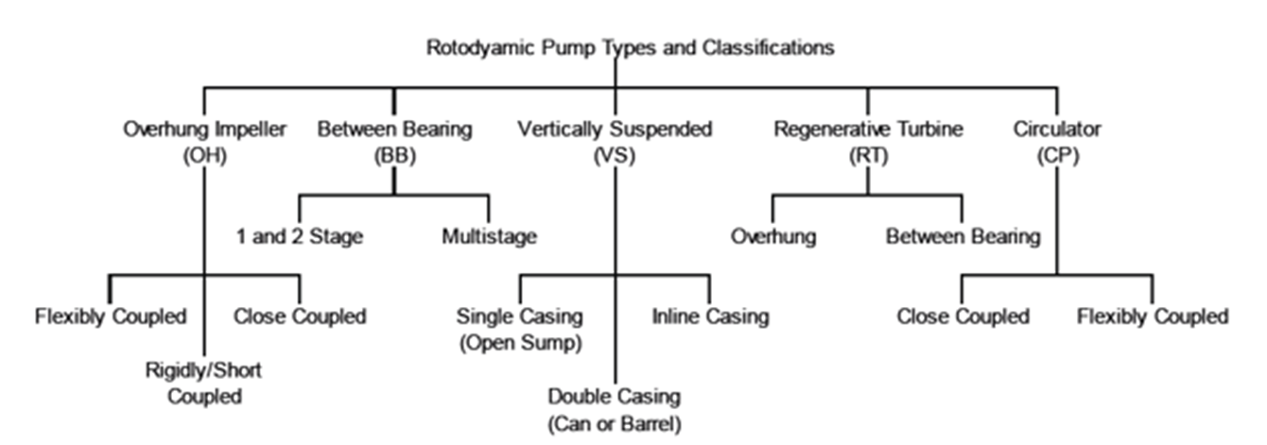
Rotodynamic Pump Classifications
Notes:
Rotodyanmic pumps can be dived into 5 major classes, they are
Overhung (OH)
Between Bearing (BB)
Vertically Suspended (VS)
Regenerative Turbine (RT)
Circulator Pump (CP)
Each class contains two to three subclasses
Based on orientation, special designation, stage count, or coupling method

Slide 26
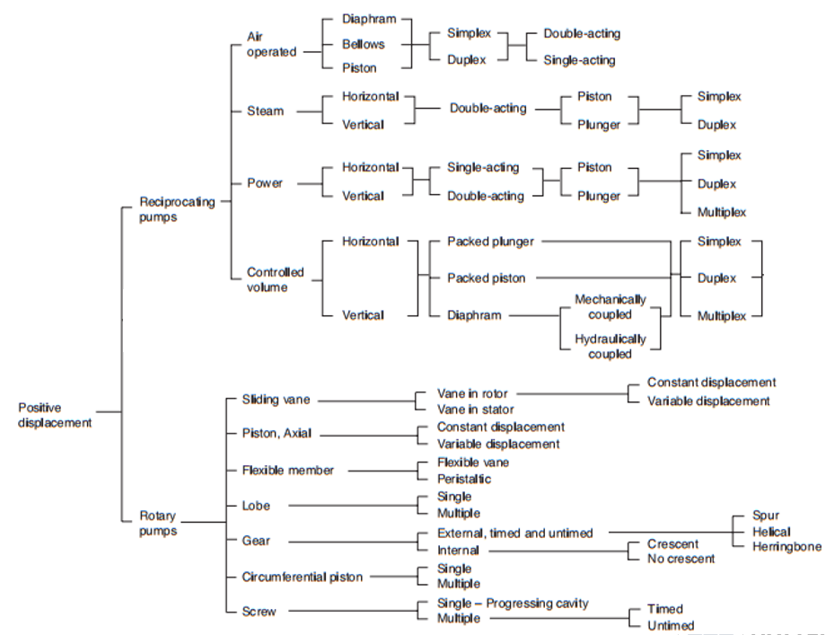
Positive Displacement
Notes:
All positive displacement pumps transfer a set volume of fluid in a pumping chamber inlet to outlet with every revolution of the shaft. Within the PD pump category are two types, reciprocating and rotary, categorized according to how the fluid conveyance occurs.
Think of a bucket. Each time you fill and empty the bucket you have a set volume that you have moved. Same with a PD pump or think of a hypodermic needle and how it reciprocates.

Slide 27
Application Considerations for Rotodynamic Pumps-Operating Conditions
Rotodynamic pumps are versatile with the ability to be used over a wide application range.
Available to meet a wide flow and head requirements
Most efficient on non-viscous liquids
Vary pump flow by changing system pressure
Designs available to handle solids
Self-priming models
High Temperature, hazardous, volatile liquids

Slide 28
PD Pump Application Consideration - Operating Conditions
  Each of these individually is a reason to use PD pumps, however, applications often surface where all of these conditions occur at the same time. For such cases a PD solution is ideal.
  Low Flow (i.e. Lubrication and Dispensing)
  Constant/Variable Flow (i.e. Circulation)
  Accurate Repeatable Flow (i.e. Metering/Dosing)
  High Pressure (i.e. Injecting)
  High Viscosity (think pastes)
  Self-Priming (i.e. Loading/Unloading)
  Shear Sensitive Liquids (paints, glues)
  Variable Viscosity (low and high viscosity with same driver)
  Entrained gasses (multiphase)
  Solids passage without damage (hard objects, fish, fruit, etc.)
  High Temperature, hazardous, volatile liquids
Notes:
Low Flow
The extremities in the range charts shown earlier are approximate but much of the charts’ common coverage below 100 GPM and above 250 PSI provide excellent applications for PD technology.
High Pressure
Many chemical, sandblasting and high pressure water cutting applications require pressures where PD pumps dominate.
Variable Pressure
Positive displacement pumps will deliver nearly constant flow against variable pressures, making them ideal when precise metering is required.
High Efficiency
For common viscous fluids where both PD and rotodynamic (centrifugal) pumps can operate the PD pump can range 10 to 40 points more efficient than the centrifugal. At viscosities greater than 500 SSU PD pumps increase in efficiency as pressure increases however, the reverse is generally true for thin liquids. In my background, any time you have a liquid over 1500 SSUs in viscosity, you should not use an RD pump due to efficiency concerns. It should be noted the use of higher efficiency PD pumps does not excuse the user from good system design practices. As an example in viscous fluid systems almost always an increase of one pipe size has an acceptable payback period for users.

Slide 29
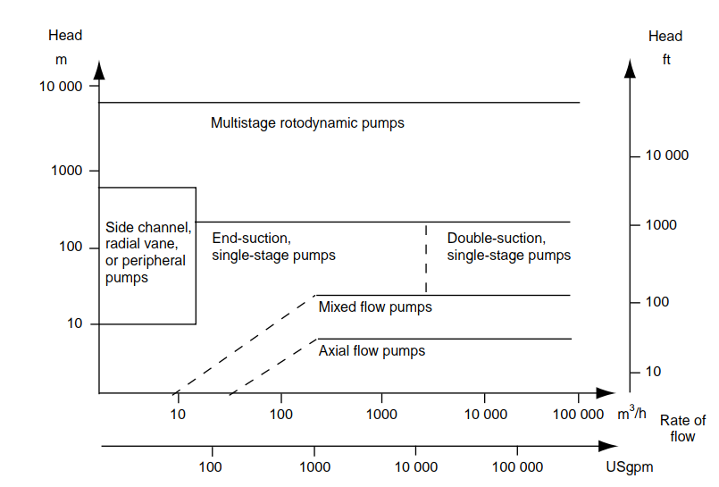
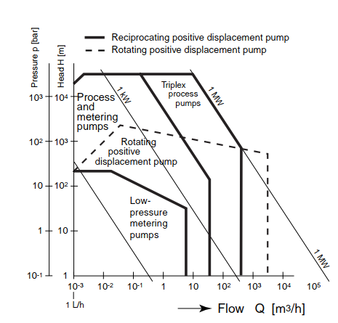
Pump Type Range Chart - General
Reference: PUMP LIFE CYCLE COSTS: A GUIDE TO LCC ANALYSIS FOR PUMPING SYSTEMS - 2ND EDITION
Notes:
The question will come up, what pump types is right for the application.
Each individual application needs to be reviewed, but provide here is a general starting point. The chart on the lefts is for rotodynamic pumps and gives general understanding of the types of pump s required for flows and head.
On the left is for positive displacement pumps. What we can see is that the PD pumps will serve lower flow and higher pressures. However this is not the entire story. So many application factors come into play related to the process fluid so this is just a starting point.
For a more detailed review of these charts, efficiency charts and application considerations review PUMP LIFE CYCLE COSTS: A GUIDE TO LCC ANALYSIS FOR PUMPING SYSTEMS - 2ND EDITION

Slide 30
Key Takeaways
Key differences between rotodynamic and positive displacement types
Subcategories of each to meet application needs
Rotodynamic pumps vary flow based on pressure
PD pumps have nearly constant flow regardless of pressure
PD pumps can be used for metering and other unique applications
Rotodynamic pumps are applied more broadly across wide applications
Notes:
In general, positive displacement pumps are ideal for applications where a constant flow is needed. They create medium to high pressure and are often an excellent way to pump oils and other viscous fluids in an efficient way. Positive displacement pumps are also extremely useful for applications requiring a combination of low flow and high pressure, and to move fluids containing suspended or fragile solids.
A major advantage of the positive displacement pump is its ability to deliver consistent and metered flow, and designs are available to handle a wide range of liquids that include solids and entrained gases.

Slide 31
Pump Operating Point
Operating point impacts efficiency & reliability
Notes:
Consider giving a one hour lunch break at this point. If so, tell them that our time is over half finished today, but we still have half the slides to go. But not to worry – since the rest of the slides are not so dense with calculations.
We will be providing a class survey through Elevate (our LMS). We should remind them that they will have an opportunity to fill it out at the end of the course.

Slide 32
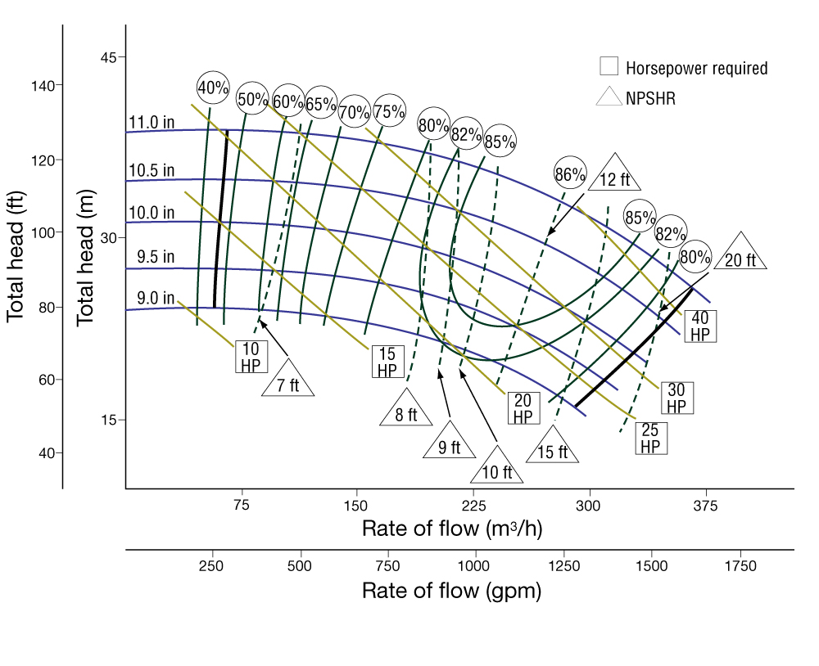
The Pump Performance Curve
A pump curve or performance curve shows
  Total head,
  Power,
  Efficiency
  NPSH3 (NPSHR)
  All as a function of flow rate
It is a LOT of IMPORTANT data contained on one sheet of paper!
Notes:
In this section we will do a more thorough review of the pump curve and how it is used for pump selection and application.
The pump curve provides a lot of important information about the pump that is needed for proper selection and sizing.
Illustrated here is a complete manufacturers curve for a model at the available trims. Well construct and review this in detail on the upcoming slides, but generally the pump curve will include the pump’s total head, power, efficiency, and NPSH requirements all plotted as a function of flow rate.

Slide 33
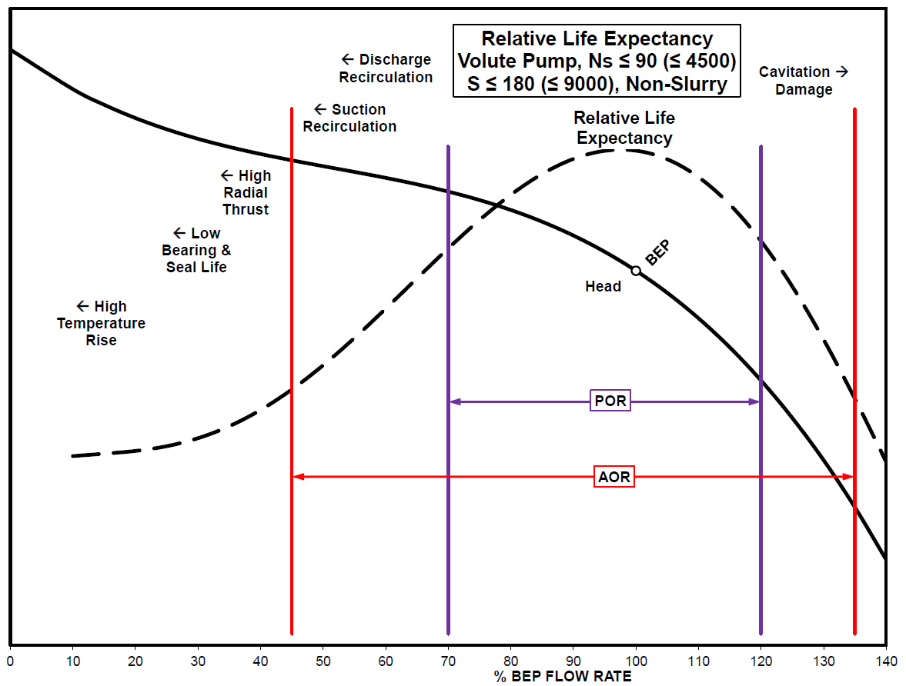
Efficiency = Reliability
Best Efficiency Point (BEP)
Preferred Operating Region (POR)
Allowable Operating Region (AOR)
Notes:
This diagram indicates the impact on pump reliability when the pump is operating outside of it’s allowable operating region. Note most of the issues occur when the pump is operating to the left of design.
The important thing to note is that when a pump is operated in the POR things like high radial loads, and recirculation do not occur, and the relative life expectancy is the greatest, but as we move outside of the POR and into the AOR hydraulic factors that decrease reliably occur, and then when we get outside the AOR additional factors occur that should be avoided.

Slide 34
Remember: Efficiency = Reliability
Outside the POR reliability suffers
Reduced Efficiency
Cavitation
Suction/Discharge Recirculation
Radial & Axial loads
Increased Shaft Deflection
Reduced Bearing & Seal Life
Liquid Temperature Rise

Slide 35
Benefits and Introduction to Pump System Optimization and Assessment

Slide 36
Achievable Benefits of Assessment & Optimization
Bottom Line: increased profitability
Energy savings, efficiency improvements and carbon reduction
Improve reliability and minimize maintenance
Match system equipment to current process market needs
Improve productivity and reduce unplanned downtime
Consistent quality of end product
Achieve corporate energy initiatives and carbon reduction
Notes:
Bottom Line: increased profitability
Energy savings and efficiency improvements
Match system equipment to current process market needs
Reliability (minimize unscheduled interruptions)
Productivity
Consistent quality of end product
Compliance with rebate and energy initiatives, Corporate Good Neighbor marketing (LEED, Green Buildings, Etc)
LEED, or Leadership in Energy & Environmental Design, is a green building certification program that recognizes best-in-class building strategies and practices.
Green building (also known as green construction or sustainable building) refers to both a structure and the using of processes that are environmentally responsible and resource-efficient throughout a building's life-cycle: from siting to design, construction, operation, maintenance, renovation, and demolition.

Slide 37
Pump System Optimization
What is System Optimization?
“The process of identifying, understanding and cost effectively eliminating unnecessary losses while reducing energy consumption and improving reliability in pumping systems, while meeting process requirements, minimizes the cost of ownership over the economic life of the pumping systems.”
Ultimately minimizing the cost of ownership over the economic life of the pumping systems
Notes:
System optimization is the act of:
Identifying and effectively eliminating unnecessary losses to Reduce energy consumption (flow, pressure/head, operating time), and Improve reliability in pumping systems while continuing to meet or improve process requirements
Ultimately minimizing the cost of ownership over the economic life of the pumping systems

Slide 38
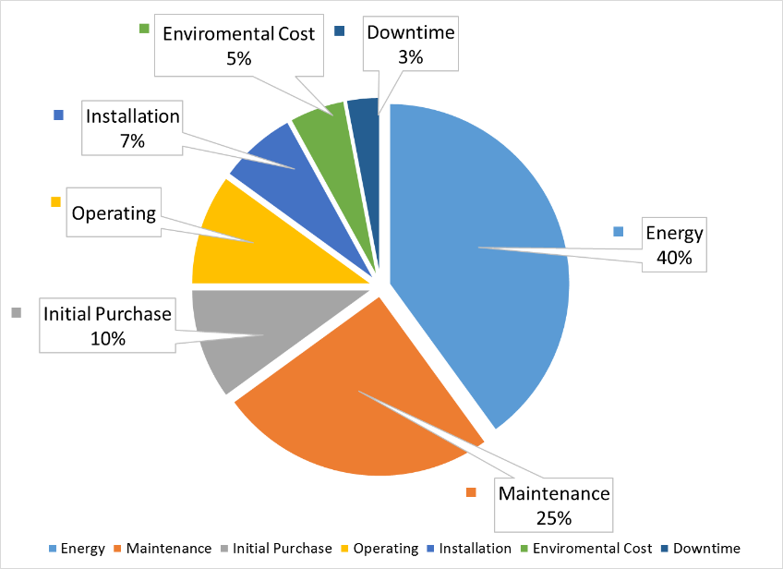
Life Cycle Cost of Typical Pumping System
Focus on Energy & Maintenance
presents 65% of LCC
Focusing on initial cost misses the big picture
On average, 20% electrical energy savings is achieved by optimizing a pumping system, but in some cases 65% or more can be realized
Notes:
Pump systems can have a 10, 20, 30 year or longer life. Over this lifetime the initial cost is a minimal portion of the total LCC.
Focusing on minimizing energy and maintenance will allow us to address the largest portion of the LCC.
For existing systems, if we focus on optimizing these systems we can generally save 20% on average and in some cases we can save 65% or more.

Slide 39
Look Beyond Energy Savings
Energy cost is a top consideration, but there are also values for non-energy benefits:
  Higher Reliability
  Increase Productivity
  Less Equipment Wear and Tear
  Reduce Maintenance Cost
  Reduce Production Losses
  Increase Capacity Utilization
  Reduce Environmental Impact
  Increase plant safety
Efficiency = Reliability
Notes:
Energy savings are important, but in many cases, the non-energy benefits outweigh the energy benefits – In order to financial justify an improvement, often you need to include the total cost of ownership, that’s why LCC analysis is important.
Energy efficiency is as much about improving an industrial system’s reliability as it is about reducing energy costs. Why? Because greater efficiency reduces wear and tear from heat and vibration – lengthening the lifespan of equipment and reducing down time for maintenance and repairs. A continuous Energy Improvement Program is one of the best ways to avoid “lost” energy that otherwise might create system inefficiency and destroy equipment.

Slide 40
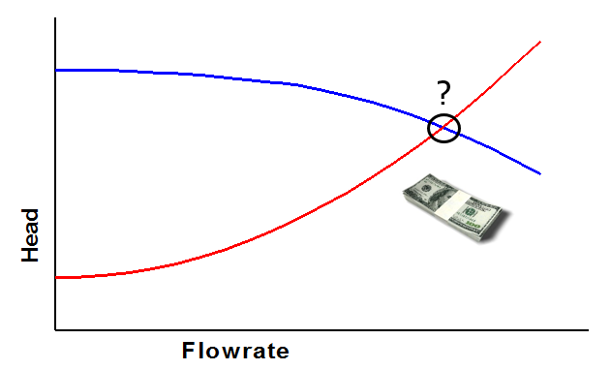
Opportunities in New Design / Existing Design
Opportunities exist in new/existing systems
New – More items can be addressed cost effectively
Existing – Generally controls and pump upgrades. System (i.e. piping) changes limited to address reliability/safety
Operating points have costs
Is this the most cost effective operating point for the system (energy & reliability)?
Notes:
We are going to discuss optimizing new systems first and then will look at existing systems.
We have the additional benefit with new systems that cost to implement improvements is far less than after the system has been designed and built.
While obvious, it is important to understand that operating points have costs.
Consider the pump and system curves .To design a new pump
system to operate at the operating point shown will cost a
certain amount of money.
The focus in this section will be two-fold:
• Identify a lower cost system to supply a given operating point
• Find alternate operating points that still satisfy design requirements but
have lower cost

Slide 41
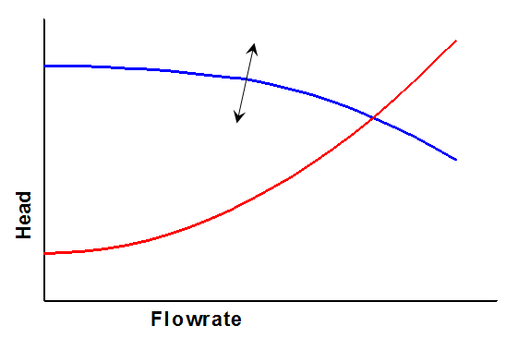
Effecting Cost Reduction: Pumps
By choosing different pumps, the pump curve can be adjusted
  The pump efficiency and BEP also adjust
The pump curve can also be changed by changing the impeller size or (fixed) speed
Notes:
When undertaking a new design, the pump must be selected. As part of the selection, the pump impeller size and pump operating speed must be
selected. The impact on the operating point is as shown where the blue curve can be moved.

Slide 42
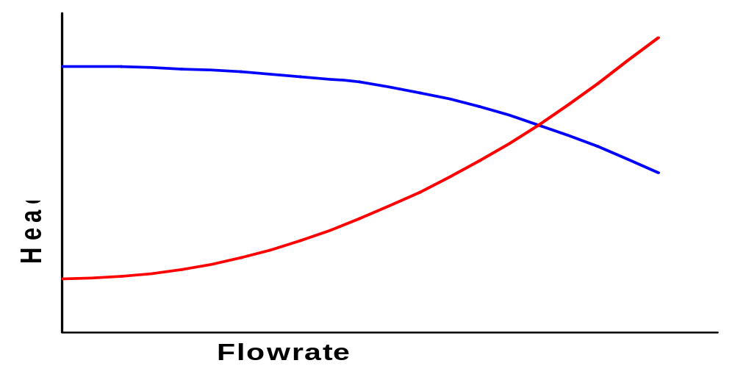
Effecting Cost Reduction: System
The system curve can be adjusted by using:
  Different pipe sizes
  Different layout
  Different pipe material
  Different components
  Etc.
Notes:
Focusing on the “system” we can adjust the system curve itself by altering the friction loss characteristics of the piping.

Slide 43
Effecting Cost Reduction: Controls
The pump curve can be adjusted using variable speed control
The system curve can be adjusted (to a limited degree) by decreasing pressure drop across high pressure drop components
Notes:
With controls such as variable speed the blue curve can also be moved.
The system curve can also be adjusted by limiting the friction loss due to control valves.

Slide 44
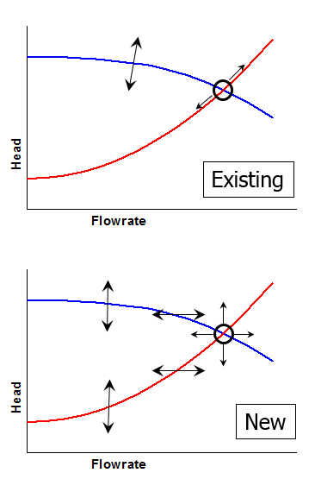
Opportunities in Existing vs.
New Systems
Existing Systems
  Opportunities typically reside in changing the pump curve
    Repair pump
    Impeller size change
    Controls (VFD)
    New pump
New Systems
  Opportunities reside in changing anything
    The operating point itself can be changed
    The cost reduction opportunity is much larger
Notes:
In practice, once the system is installed, the owner must live with these aspects of the system for the intended service life. While pumps, controls, and operations can be modified at a later date to effect cost reduction, this is rarely the case with the piping system itself. The engineer has only one chance to get the system optimally designed. In summary, the engineer has control of more variables at the new design stage—especially with regard to the system curve—and thus much greater influence over the eventual cost of building and operating the system.

Slide 45
Why do pumping systems need optimization?
How Pumping Systems Become Inefficient & have low reliability
Built for lowest first cost instead of life cycle cost
System requirements change
System designed to meet future requirements without flexible operation
Misapplication of equipment
Operating different than the design
Oversizing (safety factor or max conditions) without considering efficient normal operation
Systems age & equipment wear reduces overall efficiency
Lack of a “system approach” can hide problems that reduce overall system efficiency
Notes:
You may be asking the question “why pumping systems are inefficient or unreliable?” There are several factors that contribute to this. Upfront the system may have been built for lowest initial cost and did not consider the life cycle. The system may have been oversized for safety factor or to accommodate future conditions. The system could have aged and or the process could have changed. When we optimize, a system approach is required to evaluate all of these.

Slide 46
Opportunities for Optimization
Designers have control of up to three general variables that affect the system initial and recurring costs
  Pump and driver
  Control and operations
    VFD, control valve, bypass, etc.
  System
    Pipe material and sizes, pipe layout, tank sizes, valves, etc.
Solutions fall into four broad categories
  Reduce system head (static and dynamic)
  Reduce system flow rate or operating time
  Modify or replace equipment
  Improve maintenance and operation practices
For existing system cost reduction, opportunities are typically focused on the first two as changes to the system are typically not cost effective
Notes:
To optimize a system we typically have the ability to optimize the pump/driver, the pump controls/operations, and the system.
In new design we can typically optimize all these; however, in existing designs cost effectiveness usually limits us to items 1 and 2.

Slide 47
Pump System Costs
Notes:
To justify pump system optimization measures, we need to justify them with a life cycle cost analysis
This section will cover the elements of total life cycle cost and will also cover some financial justification methods.

Slide 48
Life Cycle Cost of Typical Pumping System
Focus on Energy & Maintenance
presents 65% of LCC
Elements of the LCC
Energy – 40 % (Ce)
Maintenance – 25% (Cm)
Initial Purchase – 10% (Cic)
Operating – 10% (Co)
Installation & Commissioning – 7% (Cin)
Environmental cost - 5% (Cenv)
Decommissioning, Downtime, Loss of Production – 3% (Cd)
Focusing on initial cost misses the big picture
LCC = the sum of (C_{ic} + C_{in} + C_{e} + C_{o} + C_{m} + C_{s} + C_{d} + C_{env})
Notes:
We need to continually remind people that the initial cost is only a small portion of the total life cycle cost. If we focus on the initial cost we are only optimizing 10% of the puzzle. Conversely when we look at energy and maintenance it makes up 65% of the LCC puzzle
This is an average, “mileage may vary” For example some systems like pipelines, the Energy and Maintenance may be 80%+ of the LCC
We also know that when we optimize systems, on average we can save 20% on average, and sometimes much more than that

Slide 49
Initial Costs & Installation Costs
Initial Costs
Typically a low percentage of LCC - <10% yet a major focus
Initial cost include
  Initial Pumping System
  Engineering
  Bid Process
  PO Administration
  Testing
  Inspection
Installation & Commissioning Costs
Cutting cost may lower reliability
Proper commissioning checks operation to limit energy and reliability costs
Costs include
  Foundation
  Grouting
  Connection to process piping & electrical wiring
  Provisions for flushing pipes
  Performance evaluation
  Validation of controls
Notes:
We will now look into each element and add some definition
The initial cost is not just the pumping system, but it should include the administration and testing
To move away from the initial cost mindset, we may need to rethink engineering, procurement & construction relationship to achieve a better LCC
It may be tempting to skimp on the installation and commissioning costs, but this will definitely result in higher maintenance costs down the road.
The manufacturers IOM should be followed as well as industry standards for the installation. Once installed proper commissioning of the pump is done to ensure the pump, system and controls are all operating correctly.

Slide 50
Energy Costs & Maintenance Costs
Energy
Largest part of LCC
  Energy usage, demand, power factor
Energy conversion or transfer devices include
  Transformer, Combo Starter, VSD, Driver, Transmissions, Pump, Fluid System
To minimize
  Include LCC in specification
  Invest in installation & commissioning
  Suitability of the pump for the application
  Improve control methods to better match system demand
  Improve Operation & Maintenance
  Improve piping
  Use energy cost to evaluate system alternatives
Maintenance
Costs include
  Spare parts and rebuilds
  Predictive and preventative maintenance tasks
  Remote monitoring
  Lubrication cost
To minimize
  Give reliability high priority
  Proper installation,
  Focus on pump selection, controls and verifying efficient operation to match the application requirements
Notes:
We know this is the largest portion of the LCC and we have been focusing on energy for most of the course so we know what goes into this cost.
To be complete we should consider all the all the components in the drive train, and do the calculation based on the average input power. This requires characterizing and understanding how the system will operate over time and seasons.
Maintenance is the second biggest piece of the LCC pie. This cost includes replacing failed components, like mechanical seals, and doing our typical preventative and predictive maintenance.
Cost can be minimized by giving reliability high priority, proper installation, and selecting the correct pump and control to match the application

Slide 51
Additional costs
Downtime/ Lost production
  Cost occurs when unexpected failures occur and the plant has be shut down or run at part load.
  Downtime costs can be very high, and exceed all the others
  It can also be a source of high anxiety when it occurs and results in assessments to understand what went wrong.
Operating
  Labor related to the operation of the system
Environmental
  Contaminant disposal
  Environment inspections
Decommissioning
  Resorting the local environment
  Generally not part an assessment for an ongoing plant
Notes:
Additional costs that should be considered are operating environmental and decommissioning.
We should never lose site of the cost of downtime. In many instances, lost production can far exceed any of the other costs, when the pump is mission critical and the plant has to shut down when it fails unexpectedly.
Operating
Operating costs are labor costs related to the operation of a pumping system. These vary widely depending on the complexity and duty of the system. For example, a hazardous duty pump may require daily checks for hazardous emissions, operational reliability, and performance within accepted parameters. On the other hand, a fully automated non-hazardous system may require very limited supervision. Regular observation of the functioning of a pumping system can alert operators to potential losses in system performance. Performance indicators include changes in vibration, shock pulse signature, temperature, noise, power consumption, rate of flow, and pressure.
Environmental
The cost of contaminant disposal during the lifetime of the pumping system varies significantly depending on the nature of the pumped product. Certain choices can significantly reduce the amount of contamination, but usually at an increased investment cost.
Examples of environmental contamination can include cooling water and packing box leakage disposal, hazardous pumped product flare-off, used lubricant disposal, contaminated used parts, such as seals. Costs for environmental inspection should also be included.
Decommissioning
In the vast majority of cases, the cost of disposing of a pumping system will vary little with different designs. This is certainly true for non-hazardous liquids and, in most cases, for hazardous liquids also. Toxic, radioactive, or other hazardous liquids will have legally imposed protection requirements, which will be largely the same for all system designs. A difference may occur when one system has the disposal arrangements as part of its operating arrangements (e.g., a hygienic pump designed for cleaning in place) while another does not (e.g., a hygienic pump designed for removal before cleaning). Similar arguments can be applied to the costs of restoring the local environment.

Slide 52
Overview of Pump System Assessments
Notes:
Lets take a look pump system assessment

Slide 53
Levels of Pump System Energy Assessment - (ISO/ASME 14414)
Level 1 assessment is a qualitative review with possible quantitative elements intended to determine the potential for significant energy savings based on further assessments and to identify specific systems that merit a greater level of attention.
Level 2 assessment is a quantitative review intended to determine energy consumption and potential savings based on measurement of a single steady‐state operating condition requiring a single set of measurements.
Level 3 assessment is a quantitative review that takes varying system demands into account by monitoring the system over a time span long enough to capture the various operating conditions which require their own set of measurements.
Notes:
There are three different levels of assessment with increasing complexity that is defined by ISO/ASME 14414. ISO/ASME is an international standard on conducting energy assessments in pumping systems. PSAP program follows these, but places a focus on the total LCC in addition to energy.
Level 1 assessments are qualitative and determine potential savings – Paper audit
Level 2 assessments are quantitative (measurement data) for a steady operating system
Level 3 assessments are quantitative for systems that vary demand

Slide 54
Implement Six Step Action Plan
Screen and prioritize your pumping systems to identify good performance improvement candidates
    Step 1a - Get management support for improving the highest priority pumping systems
Work with appropriate pumping system specialist and/or in-house team to gather and analyze additional data
Identify and economically validate improvement opportunities
Document actions and report results to management
Perform post implementation assessment
Repeat Action Plan process for other good candidate systems
Notes:
When implementing an assessment, it is good to follow an action plan as outlined here.
Screen & prioritize pumps and get management support
Develop PSA team working with appropriate specialist to gather required data
Identify opportunities
Document report to management
Perform post implementation verification
Repeat on other systems
Now lets look at these in more detail

Slide 55
Step 1 - Prescreening – Data (Where to start)
Data on plant systems that are of interest
(i.e. >50 hp, those that run 24/7)
  List of pumps
  Pump description (including: process area, pumped media, pump type, etc.)
  Equipment information (service type, time in service, shared duty, voltage)
  System history – Known problems, Change in service, etc.
  Installed motor horsepower
  Yearly operational hours (or percent operation)
  Control method (control valve, variable speed drive (VSD), by-pass)
  Maintenance records
  Cavitation noted at pump or in-system
  Design point and speed (if available)
  Operating point (if available)
Notes:
Sometimes we even need to prioritize what we screen. We may need to first identify plant systems of interest (i.e. above a certain hp), then gather information listed here.
Some typical pre screening data that will help you prioritize opportunities is listed here.
Are there any other pieces of data that would help you justify further assessment?
Systems that have unplanned failures that cause lost production?
Systems that have caused safety concerns?
Systems that have had environmental impacts?

Slide 56
Evaluate Data and Prioritize (Red Flags)
  High energy use systems:
    large motors and/or high number of operating hours
  Highly throttled control valves
  By-pass or recirculation flow control
  Higher than average maintenance costs
  Cavitation, noisy, or high vibration
  Systems that have undergone change of duty
  Multiple parallel pumps running continuously
  Frequent on/off cycling of a pump in a continuous process
  No flow, pressure, or power indication
Notes:
Evaluating the screening data should help us prioritize pumps to look at in more detail.
We will give higher priority to system that have these symptoms.

Slide 57
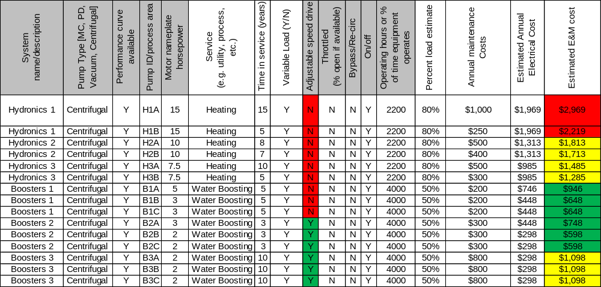
Example Pre-Screening Form
Source: Pump System Basic Assessment Guide co-developed with BC Hydro
Notes:
This worksheet is from PSM’s Basic Assessment Guide. Other tools are also available, but the process is similar. This worksheet has a macro that sorts the systems from high-low in terms of opportunity.
Gathered info from pre-screen including motor HP, estimate of annual operating hours and an estimated motor load to calculate the annual electric cost. Which in turn provides you with an E&M costProvides E&M cost

Slide 58
End Result from Screening
List of pump systems and solutions that can be implemented immediately without further analysis
Select pump systems for further analysis:
  System conditions are steady and a snapshot of performance data is required for the analysis – (Level 2 Analysis)
  There are changes in system demand over time and the system must be monitored over a longer period of time – (Level 3 Analysis)
Notes:
In some cases, the screening process results in the solution for a pump without the audit (the pump just needs to be turned off, etc.).
Some fixes are “no brainers” – the solution is obvious and not expensive to implement.
For pumps that need additional analysis, determine the level of assessment required (may need to install instruments and data loggers, etc.)

Slide 59
Tools for Pump System Optimization
Notes:
We will now discuss some tools available to assist you with your pum system optimization and assessment

Slide 60
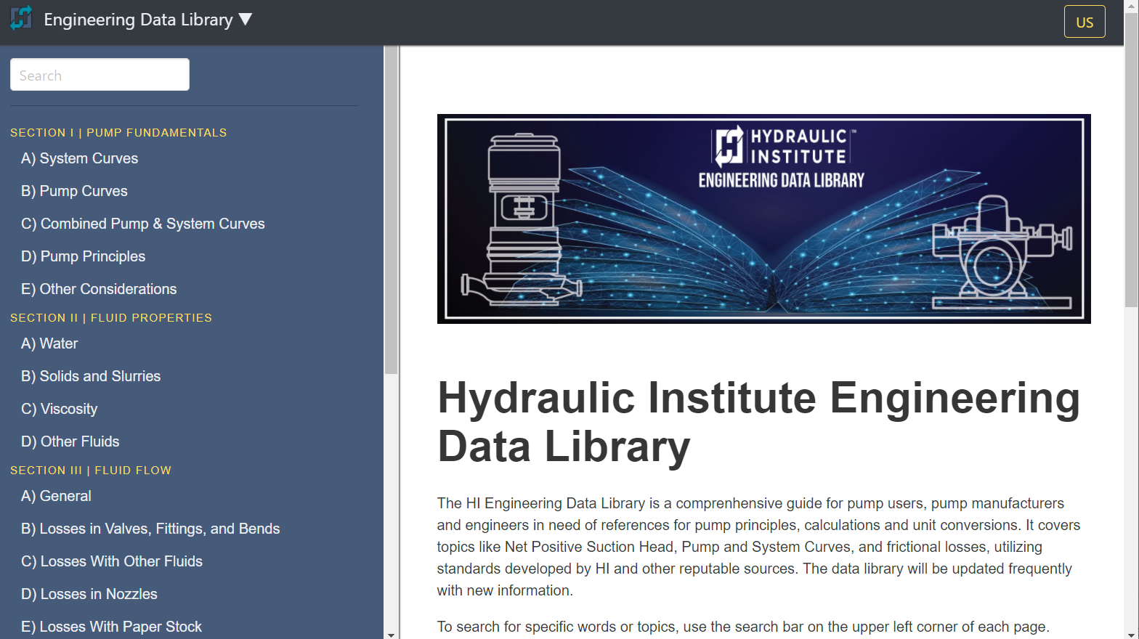



NEW Engineering Data Library
&
toolbox with software, training & calculators
www.pumps.org/freetools
https://edl.pumps.org
www.pumps.org/training
Notes:
On the HI website, pumps.org, you will find some free tools available to you. Some of these tools include the new engineering data library which is a reference used for pump principals, calculations and unit conversions, the pump savings calculator used to calculate Life Cycle Energy and Cost Savings associated with a specific pump installation as well as the DOE MEASUR tool that is a pump system assessment tool and AFT Fathom a flow modeling software

Slide 61

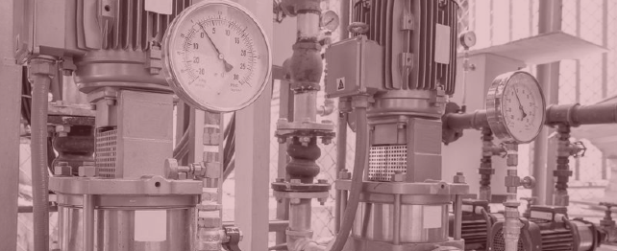
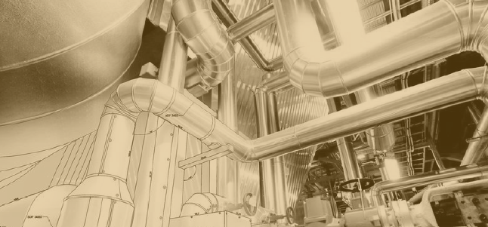

Industry Knowledge Path
Pump System Assessment
Pump System Optimization
Pump System Fundamentals
Notes:
Now let’s take a look at the knowledge path for the pumping industry. As discussed in previous slides, the BOK will be used as the path of knowledge areas required in the industry. The learning path generally follows an understanding of pump system fundamentals followed by optimization and assessment. For individuals that perform assessments as part of their job functions, HI offers the only pump centric certification in the industry, the PSAP (Pump System Assessment Professional Certification)

Slide 62


Pump Systems Assessment Professional Certification
PSAP is the benchmark for industry professionals.
Use PSAP credential to better position employees and the organization.
Assure clients of your expertise and differentiate yourself from your competitors.
PSO/PSA training provides the knowledge and tools to interact with customers on a service based engagement.
Implement proven methodologies to advance your sales position.
42
Notes:
With the demand for increased energy efficiency, reliability, and pump system optimization growing, it’s more important than ever for professionals to distinguish themselves with a certification. The Pump Systems Assessment Professional certification serves the industry by providing a benchmark for professionals performing pump system assessments. Assessments can serve as a tool to better position yourself and your organization in this competitive market and a PSAP credential can give you an edge by providing clients and stakeholders with a higher level of confidence of your skills and abilities which has been evaluated by a reputable, nationally recognized third-party organization, the Hydraulic Institute. With a pool of nationally certified pump systems assessment professionals, the industry can more confidently implement pump system assessments and be assured that the assessment is performed at the highest level of quality and comprehensiveness.

Slide 63


