Slide 1
Is my oil degrading?
What can I do?
Sanya Mathura

Slide 2
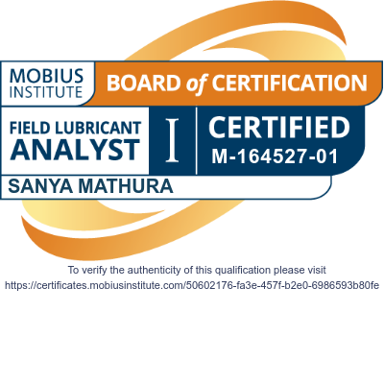
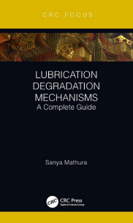
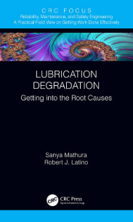
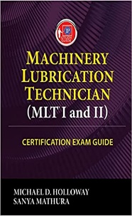
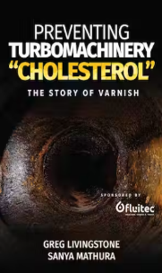
Sanya Mathura, REng, MLE
Founder & CEO
BSc in Electrical & Computer Engineering
MSc in Engineering Asset Management
Technical Editor
Board member
Columnist
Series Editor

Slide 3
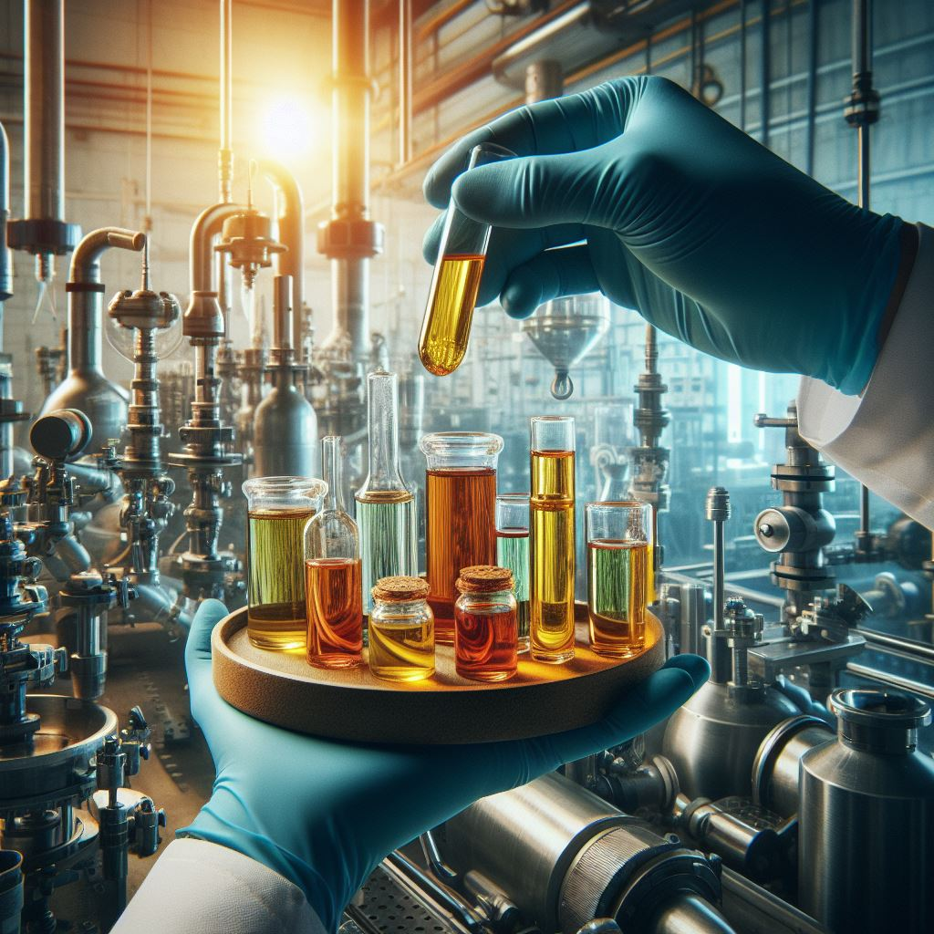
What will we cover?
What is degradation?
How can we identify it?
What can we do?

Slide 4
What is degradation?

Slide 5
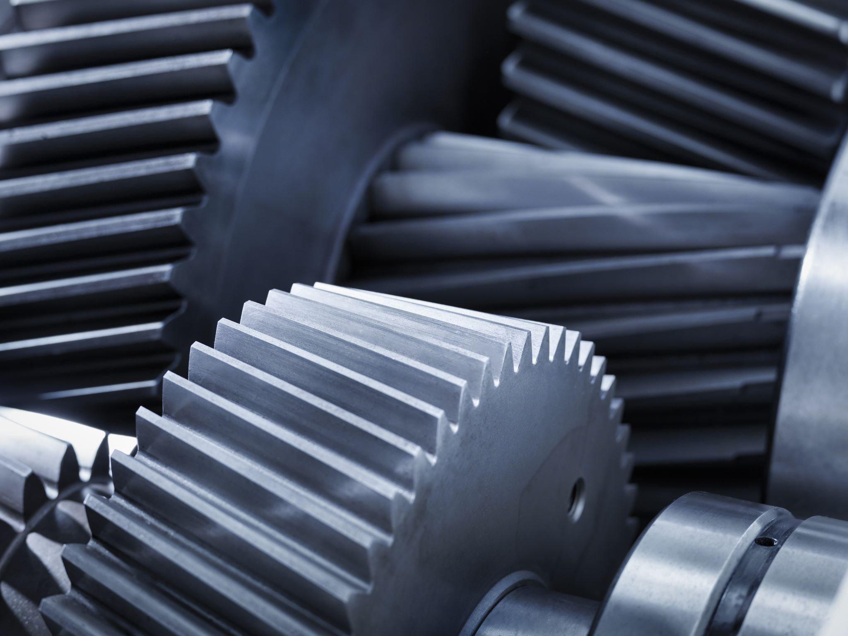
Functions of a lubricant
Remove Contaminants
Reduce Friction
Improve Efficiency
Minimize Wear
Distribute Heat

Slide 6
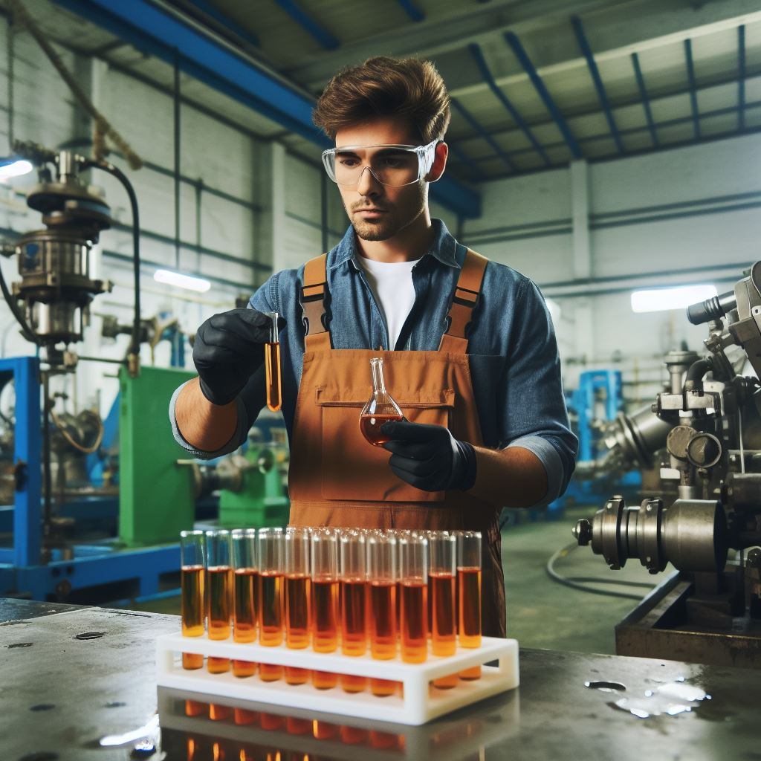
What is lubricant degradation?
Service life
Occurs throughout the service life of the lubricant.
No longer protects
Baseline for change occurs when further deterioration leads to a level whereby it can no longer protect the system.

Slide 7
Various Degradation modes
1
Oxidation
2
Thermal Degradation
3
4
Electrostatic Spark Discharge
Microdieseling
5
Additive Depletion
6
Contamination

Slide 8
How can we identify it?

Slide 9
Degradation processes
Oxidation
Loss of antioxidants
Producing varnish & sludge
Thermal degradation
Increase in temp over 200°C
Producing coke (carbon deposits)
Microdieseling
Entrained air – Antifoaming property
Producing varnish, carbon insoluble, soot, tars, resins
Electrostatic Spark Discharge
Increase in conductivity of the oil
Producing varnish sludge
Additive Depletion
Loss of additives
Producing deposits
Contamination
Foreign particles present
Producing various deposits

Slide 10
Oxidation (lab tests)
RULER® & RPVOT
MPC
Colour
FTIR
Acid Number
25-35 Abnormal
>35 Critical
Presence of insoluble
Increase of
0.3 mgKOH/g
<25% new oil value
Rapid Changes

Slide 11
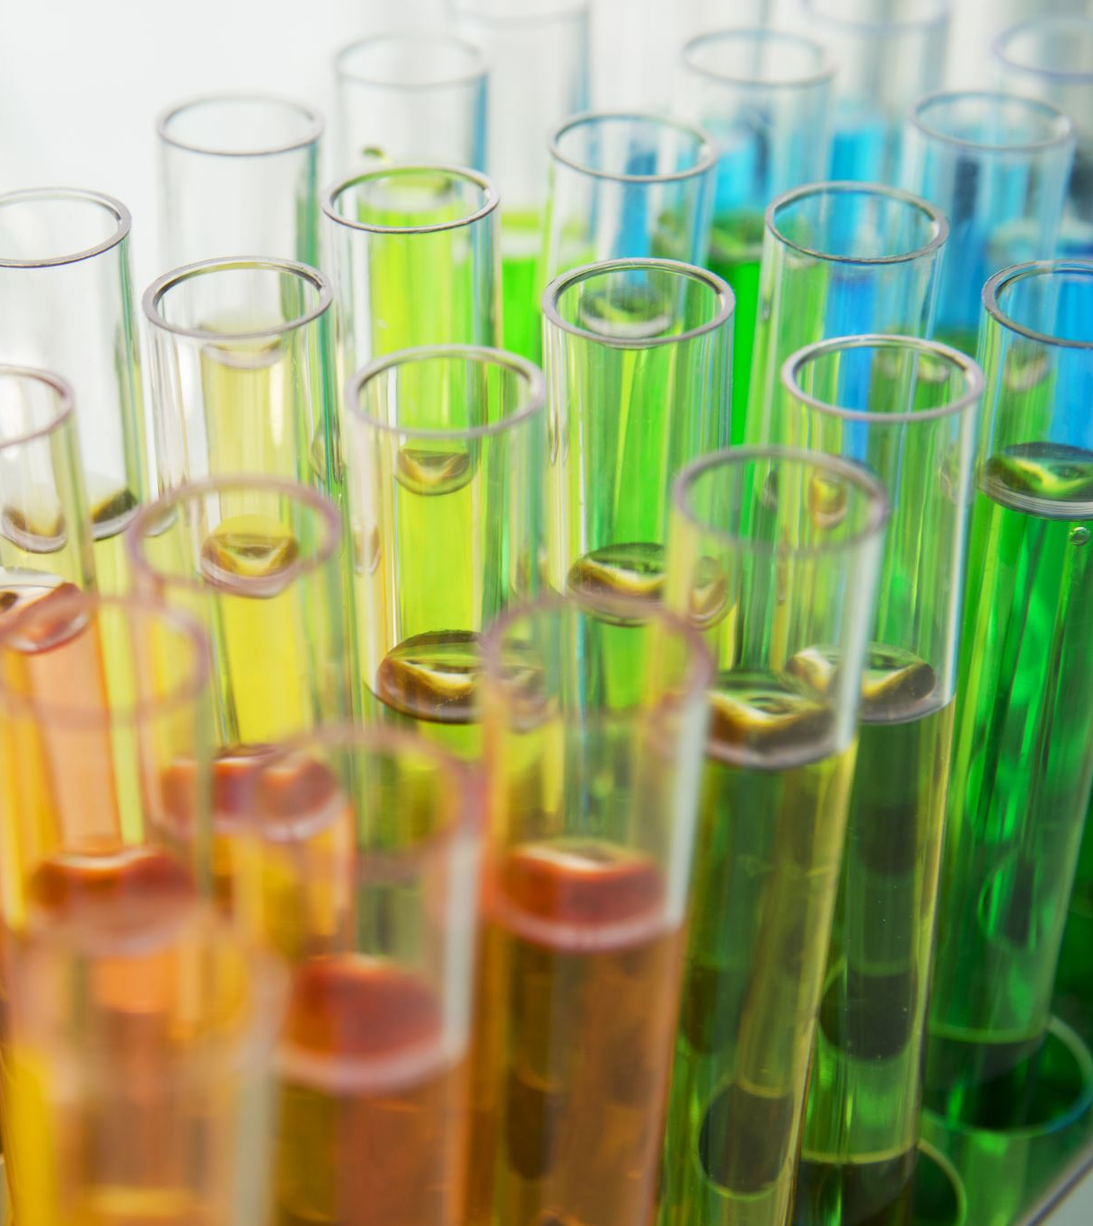
Thermal Degradation (lab tests)
Viscosity
Decrease of 5%
Colour
FTIR
Rapid Changes
Presence of Carbonaceous Deposits

Slide 12
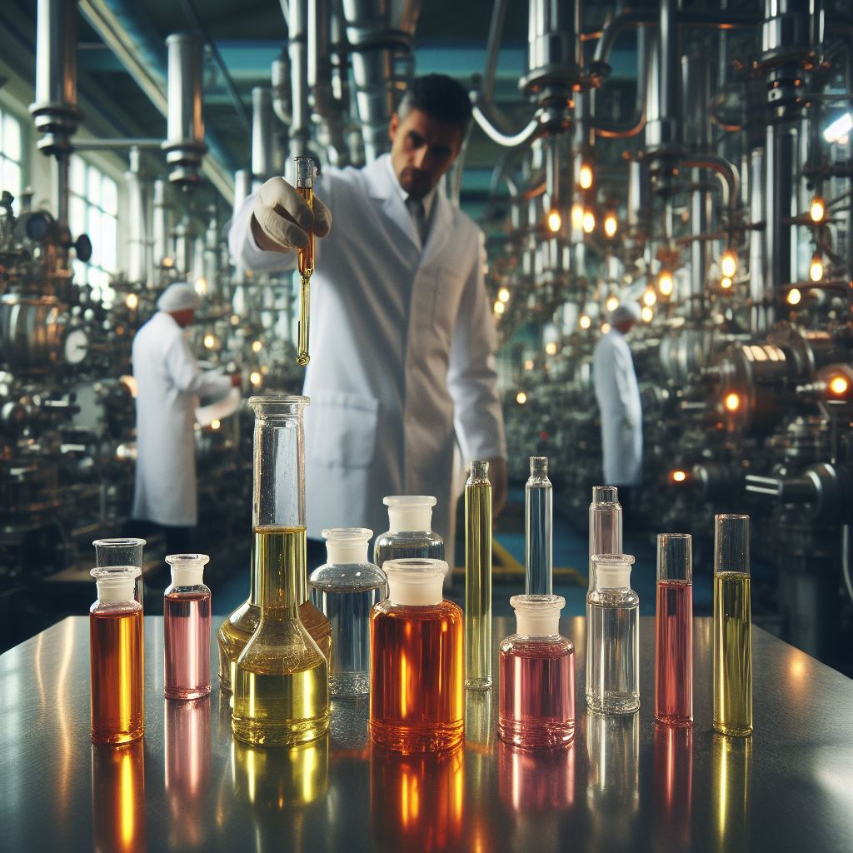
Microdieseling (lab tests)
Visual Inspection of Components
Is cavitation present?
FTIR & QSA
Presence of these by-products:
Soot, Tars, Sludge (High Implosion)
Carbon Insolubles such as Coke, Tars or Resins (Low Implosion)

Slide 13
Electrostatic Spark Discharge (lab tests)
Filter Inspection
FTIR & QSA
RULER®
DGA
Presence of burnt and clogged membrane
Presence of Varnish, Sludge or Insoluble materials
Presence of Acetylene, Ethylene and Methane
Depletion of Antioxidants (<25%)

Slide 14
Additive Depletion (lab tests)
FTIR & QSA
Presence or Absence of Additives
Colour
Use lab guidelines (for different additives)
QSA
Presence of Insoluble materials
RULER® & RPVOT
Presence or Absence of Antioxidant Additive (<25%)

Slide 15
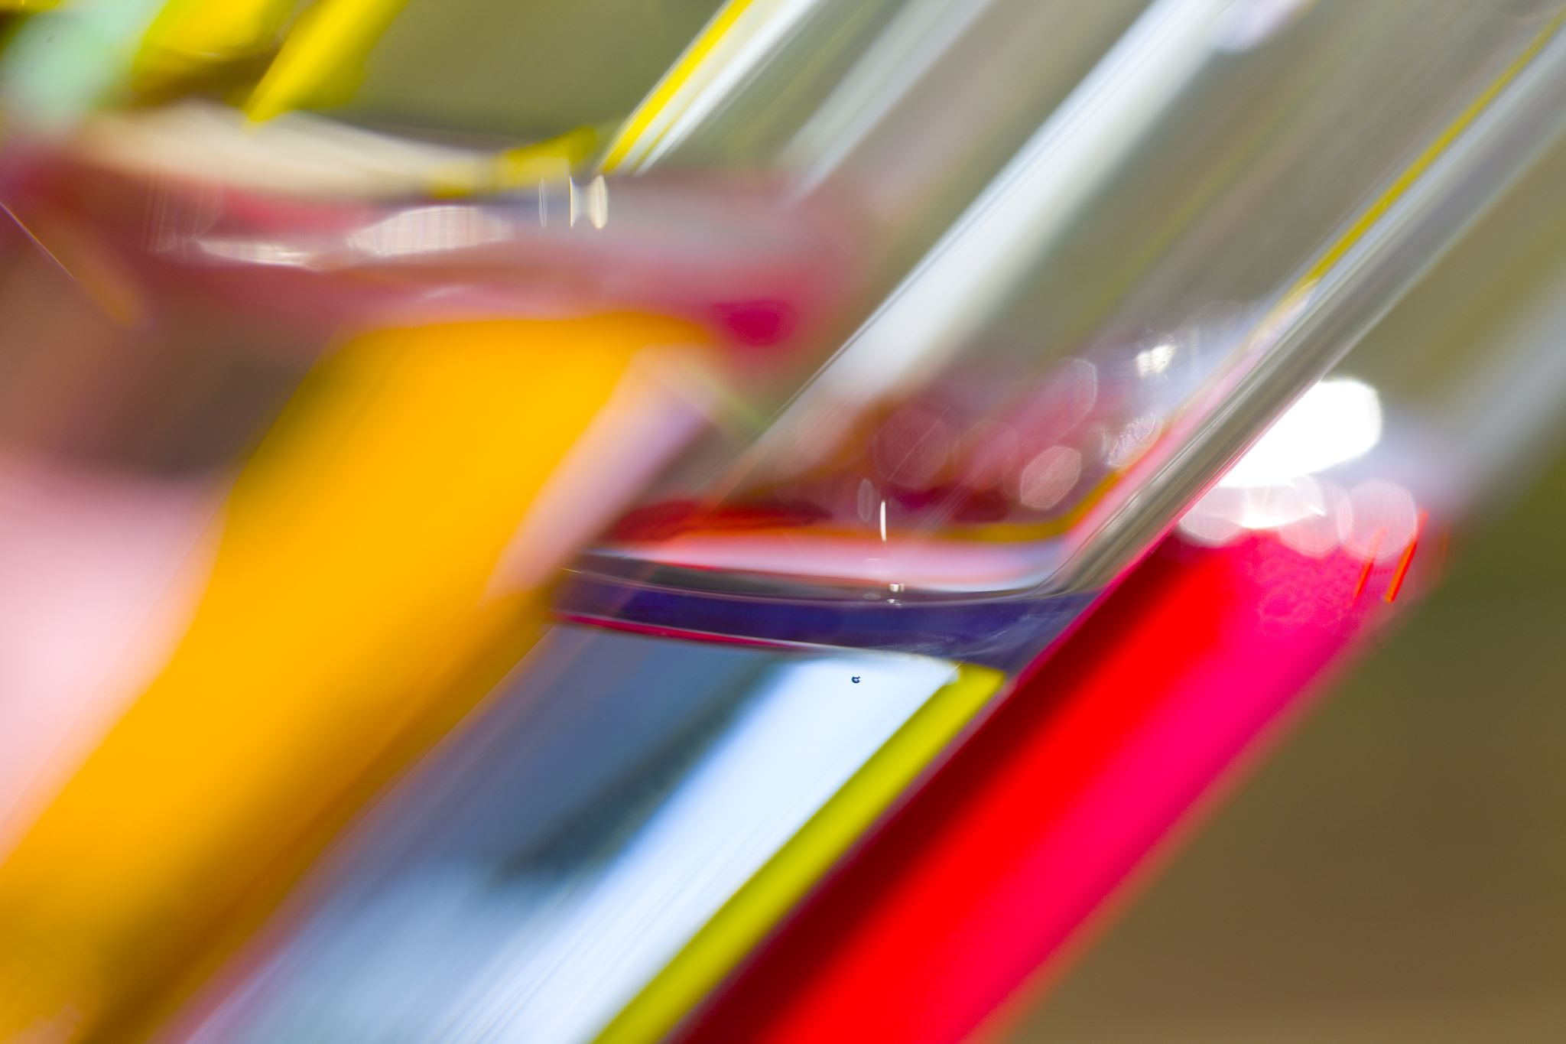
Contamination (lab tests)
Colour
Use lab guidelines
Presence of Water / Fuel / Coolant
Presence of any foreign material

Slide 16
What can we do?

Slide 17
Dealing with Degradation
1. Understand Equipment
2. Determine Applicable tests
3. Interpret the Results
4. Implement Measures

Slide 18
1. Understanding the Equipment
Decide criticality before assigning Lab tests
Is it CRITICAL?
Is it SEMI CRITICAL?
Is it NON-CRITICAL?

Slide 19
2. Determine Applicable Tests
ASTM D445
Viscosity trend changes and monitor changes of +/-5%
Presence of Water / Fuel
Contaminants such as water or fuel can degrade the lubricant and promote other Degradation Mechanisms.
ASTM D664 / ASTM D2896
Increases in TAN of 0.3mgKOH/g or Decreases of 50% of TBN value can indicate the presence of acids as by-products of degradation mechanisms.
Concentration of Additives, Metals or Contaminants
Presence or Absence of any of these items can indicate that degradation is occurring in the lubricant.

Slide 20
3. Interpreting the Results
Conditions
Increase in Viscosity
Spike in Acid Number
Dark colour
No water present
Mode present?
Oxidation?
Contamination?
Verify
Elemental
RULER
MPC
RPVOT

Slide 21
4. Implementing Measures
Chemical Filtration
Oxidation
Adjusting Clearances
Reduce temperatures
Residence Time
Reduce temperatures (Thermal Degradation)
Allow air to escape (Microdieseling)
Kidney Loop Filtration
Remove contaminants (Contamination)
ESD
Antistatic Filters
ESD

